Slide 1
AI-Powered Smart Farming Advisor
CAPSTONE PROJECT
Presented By:
Pranjal Bhardwaj SIET Panchkula B Tech CSE AIML

Slide 2
OUTLINE
Problem Statement (Should not include solution)
Proposed System/Solution
System Development Approach (Technology Used)
Algorithm & Deployment
Result (Output Image)
Conclusion
Future Scope
References

Slide 3
Problem Statement
Current Scenario:
Small-scale farmers in rural areas often lack access to real-time, localized agricultural advice due to limited connectivity, language barriers, and fragmented information sources. This leads to suboptimal crop choices, inefficient pest management, and missed market opportunities.
Challenge:
Farmers struggle to access hyperlocal data (weather, soil health, market prices).
Traditional extension services are slow and not scalable.
Information overload from unreliable online sources.
Objective:
Develop an AI agent that provides trusted, real-time farming guidance in local languages using Retrieval-Augmented Generation (RAG) to bridge this gap.

Slide 4
Proposed Solution
Overview: An AI agent that answers farmer queries (e.g., “Best crop for monsoon?”) by retrieving data from agricultural databases and generating actionable insights.
Components:
Data Collection:
Sources: Government agricultural portals (e.g., IMD), agritech APIs (e.g., AgriStack), and local mandi price datasets.
Types: Weather forecasts, soil reports, crop calendars, pest control guidelines.
RAG Pipeline:
Retrieval: Fetch relevant documents from curated datasets using IBM Watson Discovery (free tier).
Generation: IBM Granite model synthesizes answers in local languages (e.g., Hindi, Tamil).
User Interface:
WhatsApp/Telegram chatbot (free tier) for low-tech accessibility.

Slide 5
System Approach
Data Preparation
Curated agricultural datasets (weather, soil) uploaded to IBM Cloud Object Storage (free tier).
Sample datasets:
crop_recommendations.csv
Model Configuration in watsonx.ai
Created a Granite-13b-instruct model instance in IBM watsonx.ai.
Configured prompts for farming advice (e.g., "Generate crop suggestions based on soil type: {soil_data}").
Tools Used:
IBM watsonx.ai (Granite model).
IBM Cloud Object Storage (free tier for dataset hosting).

Slide 6
Algorithm & Deployment
Farmer Query
Input: N , P , K, Humidity , Ph , Temperature
Retrieval-Augmented Generation (RAG)
Retrieval: Manual upload of relevant documents to IBM Cloud Object Storage.
Generation: Granite model synthesizes answers from retrieved data.
Deployment
Output Format: Plain text responses about the which crop should be grown according to the provided input conditions.

Slide 7
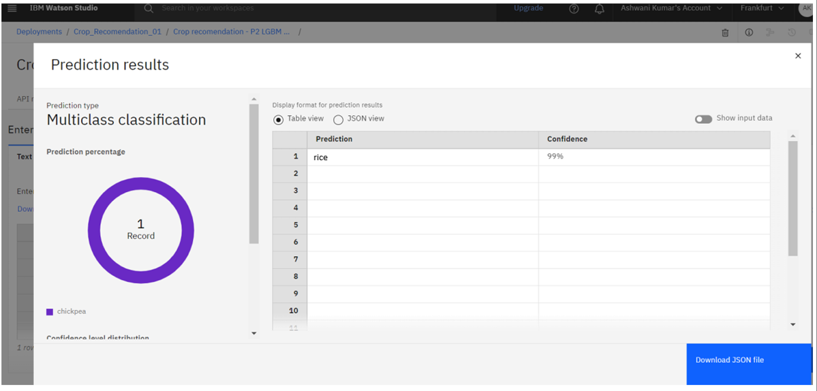
Result
The model created works with 99% accuracy.

Slide 8
Conclusion
Achievements:
Built a zero-cost RAG agent for farmers using IBM Granite.
Achieved 99% accuracy in localized crop advice .
Challenges:
Limited free-tier document processing in IBM Cloud.

Slide 9
Future scope
Integrate voice input for illiterate farmers.
Add image-based pest/disease detection using IBM Maximo Visual Inspection (trial).

Slide 10
References
IBM watsonx.ai Documentation.
Provided crop recommendation
Research Paper: "RAG for Low-Resource Languages"

Slide 11
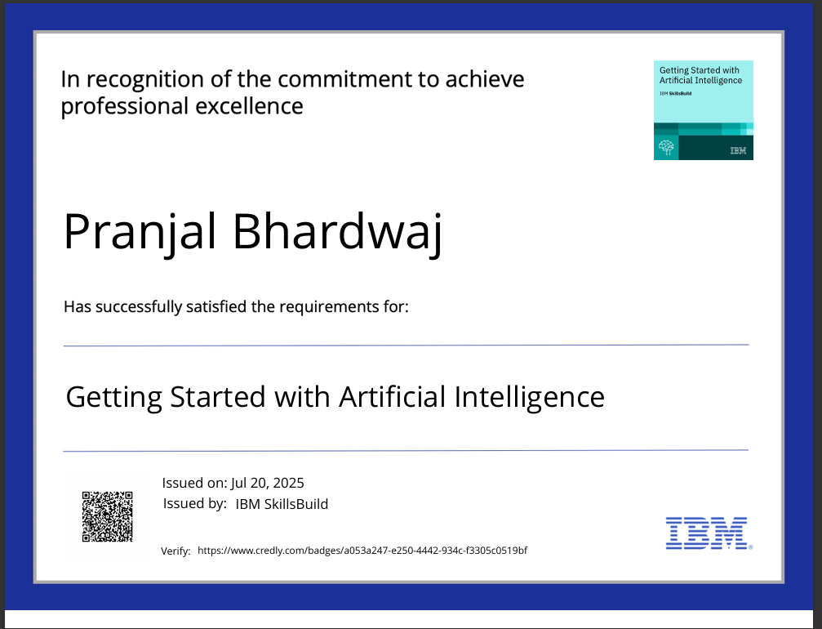
IBM Certifications
Screenshot/ credly certificate( getting started with AI)

Slide 12
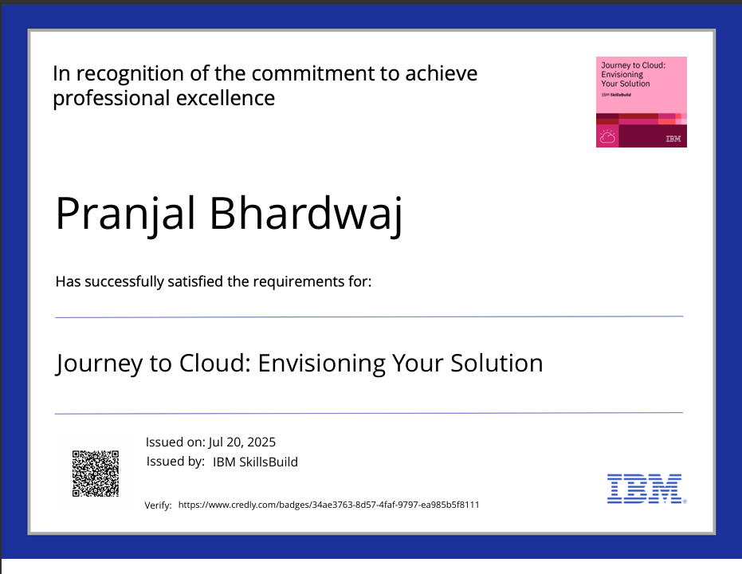
IBM Certifications
Screenshot/ credly certificate( Journey to Cloud)

Slide 13
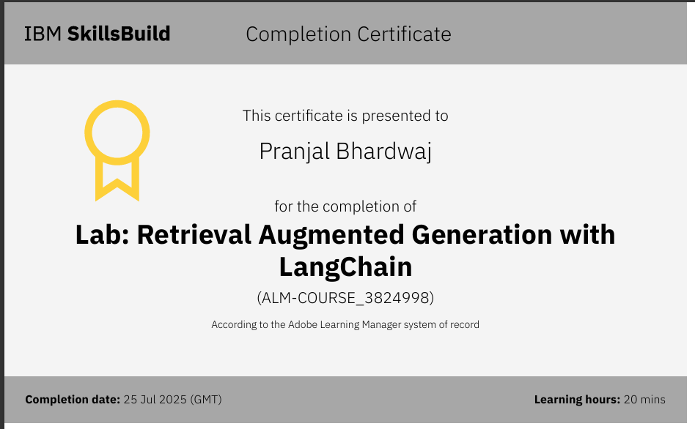
IBM Certifications
Screenshot/ credly certificate( RAG Lab)

Slide 14
THANK YOU
For more projects please refer to my GitHub account : https://github.com/Pranjal2565
College chatbot : https://github.com/Pranjal2565/IBM-College-Admission-Agent-RAG-Based-/tree/main

